Slide 1
Autonomous Cars
Tanner, Jake, Gerardo

Slide 2
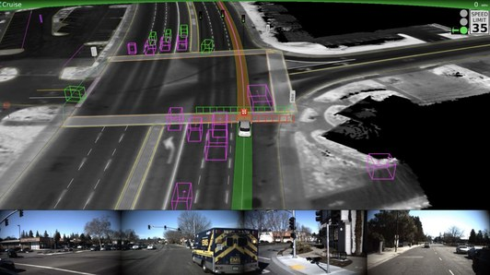
How they work ..
Autonomous cars (driverless, self-driving, auto-driving, etc.) have an arsenal of information gathering tools
LIDAR (Laser Illuminating Detection and Ranging) system that create a 3D model of the surrounding environment
Short to long range radar detection
Mounted cameras and sensors
Each collects useful information, but it has to be processed and given meaning, which is done by artificial intelligence
Impossible to “hard-code” all if .. then scenarios
Car-to-car instantaneous sharing of data
Faster routes based on traffic, refueling when needed, etc.

Slide 3
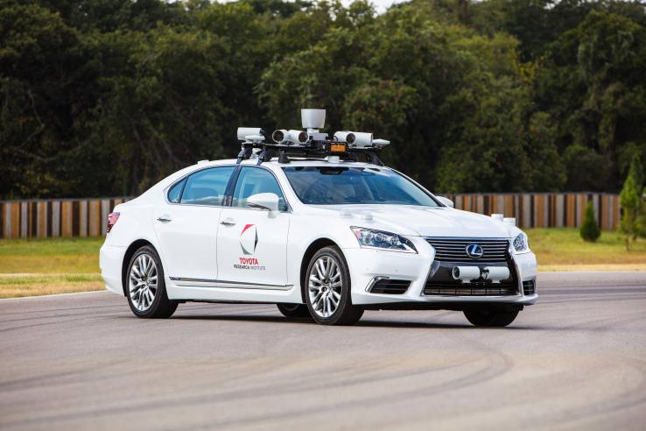

Slide 4
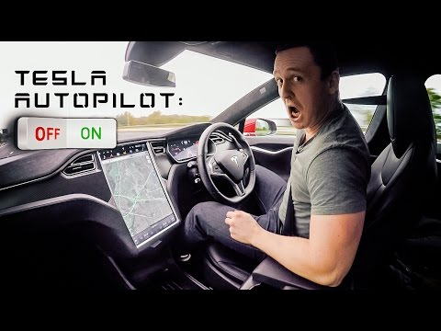
Video.. 1:15

Slide 5
But why?
This technology offers the possibility of significant benefits such as:
Reducing crashes
Reducing congestion
Reducing fuel consumption
Increasing mobility for the disabled
No road rage
Vehicle occupants could spend travel time engaged in other activities
Repurposing parking lots since these vehicles won’t need proximate parking

Slide 6
A.I. applications
Unlike human drivers, autonomous cars have the ability to share experiences and information in real time by a fluid AI algorithm
This type of active learning can allow a particular system to have an improved reaction to a situation that it hasn’t experienced first hand yet.
Infotainment
incorporate speech recognition, gesture recognition (including handwriting recognition), eye tracking and driver monitoring, virtual assistance, and natural language interfaces

Slide 7
Issues with artificial intelligence ...
Hardware and software are evolving at an unimaginable rate
But machine learning and artificial intelligence are lagging behind
As in, there is no up-to-par standardized artificial intelligence algorithm accepted as such across the industry
Each company (Google, Tesla, Uber, etc ..) are developing their own deep learning algorithms, which prohibits ALL of these autonomous cars from communicating on a large scale which is vital to advancing the technology.
Not necessarily an issue, but at the moment, highly autonomous driving (driver doesn’t really need to be paying attention..) only really works on major highways.

Slide 8
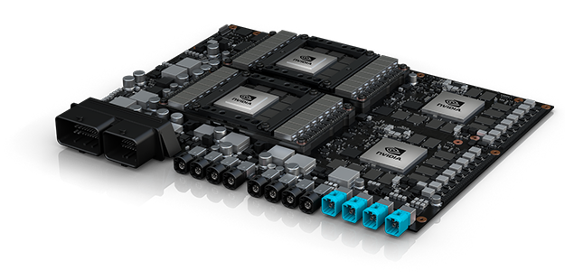
NVIDIA DRIVE PX Pegasus
320 trillion operations a second
powered by four high-performance AI processors
two next-generation discrete GPUs with hardware created for accelerating deep learning and computer vision algorithms
Robotaxis
Today.. trunks resemble small data centers loaded with racks of computers with server-class NVIDIA GPUs running deep learning, computer vision and parallel computing algorithms
Impractical for production
Plan is for customer to order type of car based on destination and activities planned along the way (what they want to do while in transit).

Slide 9
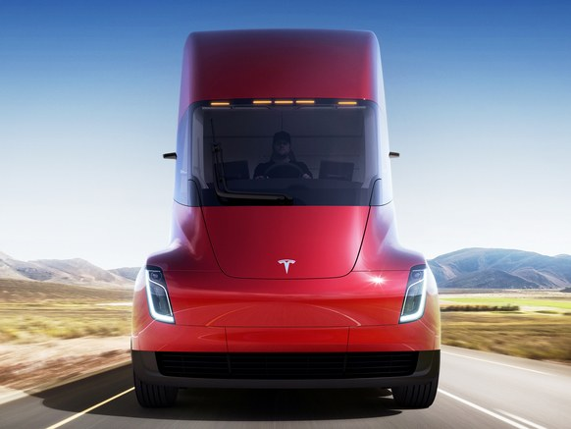
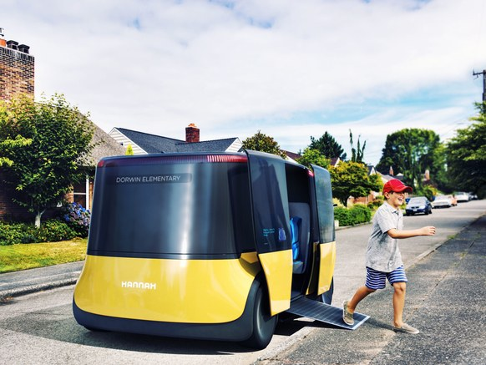
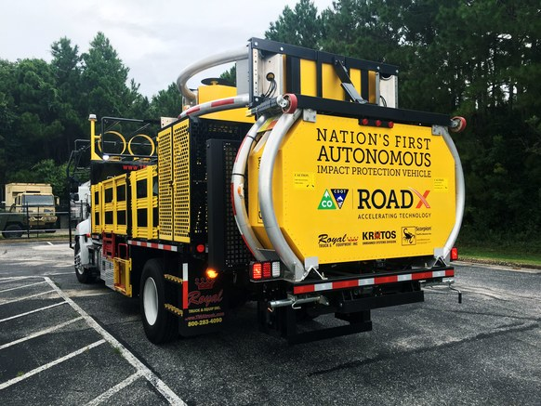
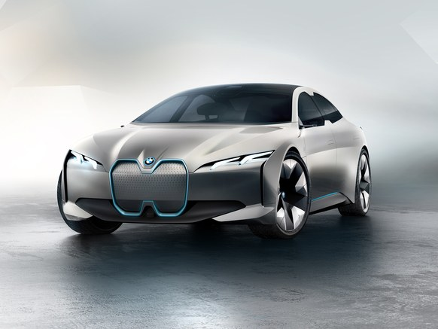
So…
What’s
next?

Slide 10
Works Cited..
https://www.codementor.io/ashish1dev/autonomous-cars-and-artificial-intelligence-ai-adzk2yk4x
https://readwrite.com/2016/12/20/ai-driving-future-autonomous-cars-tl4/
http://www.roboticstrends.com/article/how_ai_is_making_self_driving_cars_smarter
https://phys.org/news/2017-10-artificial-intelligence-autonomous-cars.html
https://www.theengineer.co.uk/ai-autonomous-cars/

